Slide 1
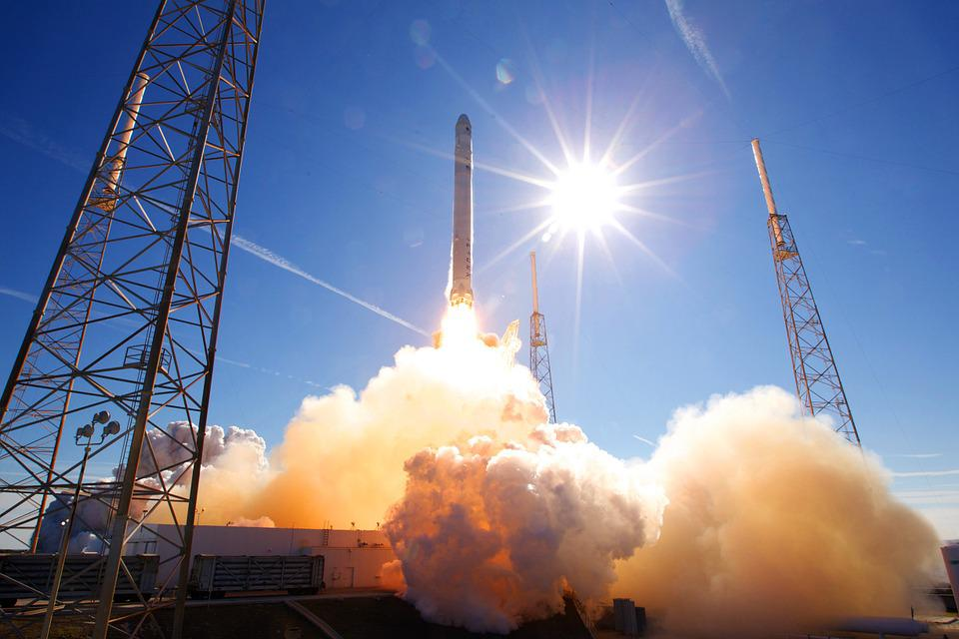
Flying high!
Calculating the amount of energy needed to launch a rocket

Slide 2
Stay safe
Whether you are a scientist researching a new medicine or an engineer solving climate change, safety always comes first. An adult must always be around and supervising when doing this activity. You are responsible for:
ensuring that any equipment used for this activity is in good working condition
behaving sensibly and following any safety instructions so as not to hurt or injure yourself or others
Please note that in the absence of any negligence or other breach of duty by us, this activity is carried out at your own risk. It is important to take extra care at the stages marked with this symbol: ⚠

Slide 3
Context – blast off!
Rockets carry satellites, people and supplies into space
It takes a lot of energy to get a rocket from the ground into space
The amount of energy increases as the weight of the rocket gets heavier

Slide 4
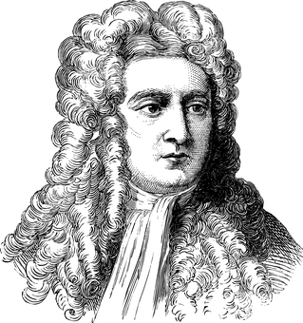
What is escape velocity?
Scientists have known for over 200 years that anything that goes fast enough straight up can ‘escape’ the earth and fly into space.
This rate of movement is called the ‘escape velocity’.
They knew this because the maths said so. Sir Isaac Newton proved it but some still didn’t believe it.
It wasn’t until the launch of the first satellite into space in 1957 that it was really used for real.
Sir Isaac Newton.
1643-1727
(Great Hair)

Slide 5
Escape velocity
At the Earth’s surface, if atmospheric resistance is disregarded, escape velocity = 11.2 km/s
That is equivalent to 40,320 km/h or 25,053 miles per hour!
For comparison, the speed of sound is just 1225 km/h – so escape velocity is 32.9 x the speed of sound!
At the surface of the moon the escape velocity is approximately 2.4 km/s
Notes:
Source of escape velocity value https://www.britannica.com/science/escape-velocity
Learners could be asked to think of something really fast and work out whether it is faster or slower than escape velocity.

Slide 6
Energy formula
To calculate the amount of energy needed for something to reach escape velocity we can use the formula:
Mass
E = ½ mv²
Energy
Velocity
E is for energy, measured in joules (J)
m stands for mass, measured kilograms (kg)
v stands for velocity, measured in metres per second (m/s)

Slide 7
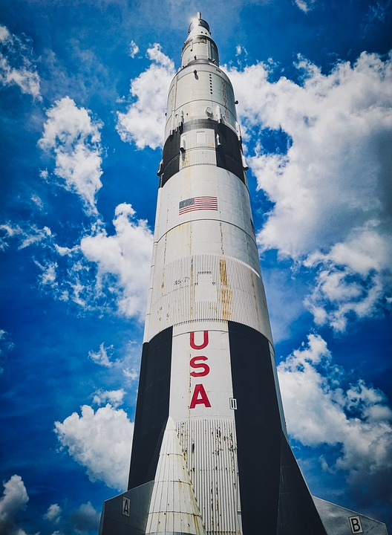
Rocket mass
The biggest rocket ever was the Saturn V
It launched the NASA Apollo missions into space
It had a mass of 2.8 million kilograms = 2,800,000 kg
Most of that was fuel to launch the rocket itself!
The newer Space X rockets have a mass of 1,420,788 kg
Notes:
Source https://www.nasa.gov/audience/forstudents/5-8/features/nasa-knows/what-was-the-saturn-v-58.html
Source https://www.spacex.com/vehicles/falcon-heavy/

Slide 8
Calculation for Space X rocket
Escape velocity is 11.2 km/s, which is 11200 m/s
The Space X Falcon has a mass of 1,420,788 kg
So, E = ½ mv² = ½ (1,420,788 x 11200²)
E = 89,111,823,360,000 J, or 8.9 x 10¹³ J
That’s a very big number indeed!
Perform the same calculation for the Saturn V rocket

