Slide 1
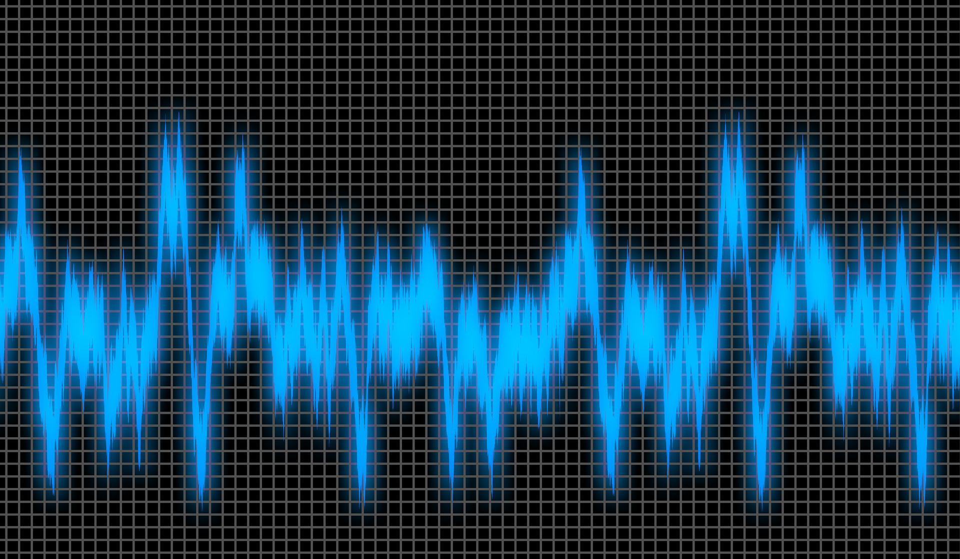
Measuring Noise
Measuring the amount of noise
produced by different activities

Slide 2
Stay safe
Whether you are a scientist researching a new medicine or an engineer solving climate change, safety always comes first. An adult must always be around and supervising when doing this activity. You are responsible for:
ensuring that any equipment used for this activity is in good working condition
behaving sensibly and following any safety instructions so as not to hurt or injure yourself or others
Please note that in the absence of any negligence or other breach of duty by us, this activity is carried out at your own risk. It is important to take extra care at the stages marked with this symbol: ⚠

Slide 3
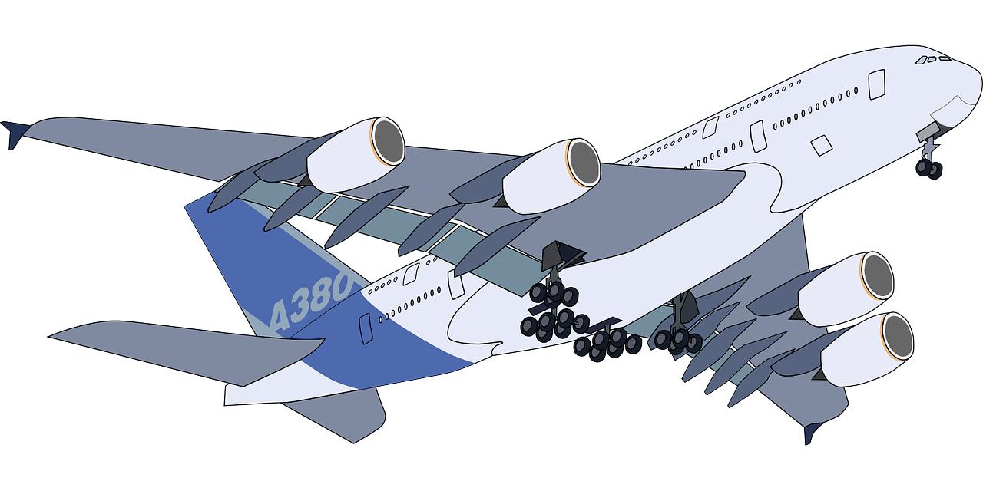
What is Noise?
Noise is a sound, especially one that is loud or unpleasant or that causes disturbance
It can be a problem at airports when aircraft take off and land

Slide 4
Noise measurement
‘Loud’ noise damages hearing – this can be immediate for really loud noises or build up over time
Noise is measured in Decibels (Db)
Noise is not a linear scale
Every +3Db is double the noise level
If exposed to noise over 85 Db, ear protection must be worn

Slide 5
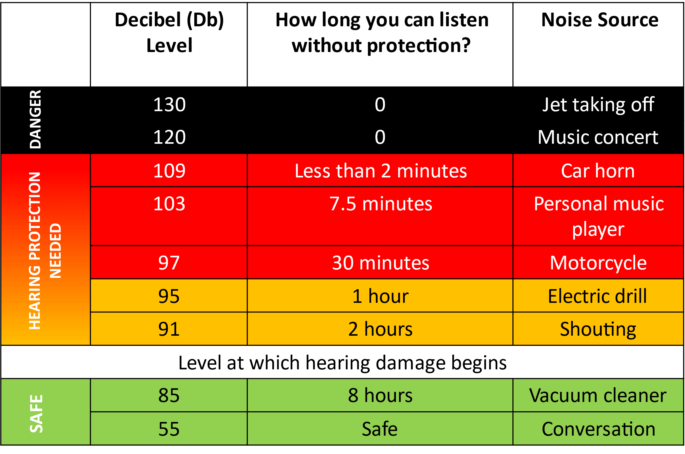
Noise Levels
Notes:
Image source: https://s32891.pcdn.co/wp-content/uploads/2015/10/hearing-loss-noise-levels.jpg

Slide 6
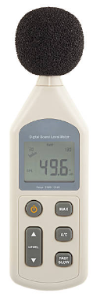
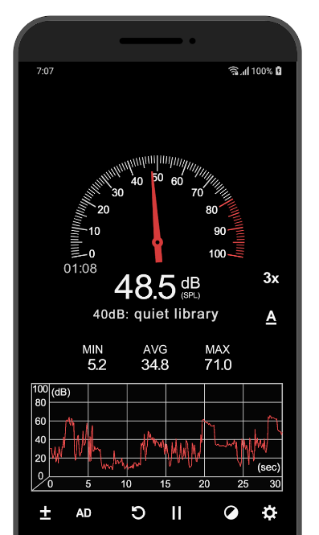
Measuring noise
Noise can be measured using a sound meter …
… or a smartphone app
Notes:
Phone app image source: https://play.google.com/store/apps/details?id=com.gamebasic.decibel&hl=en_GB&gl=US

Slide 7
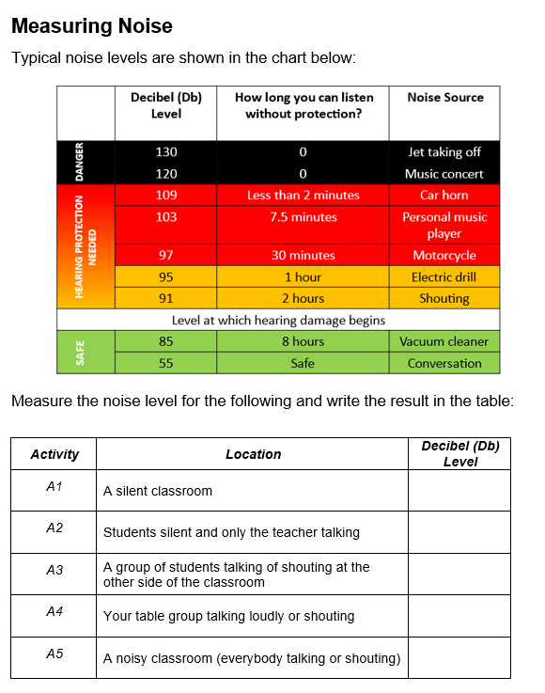
Measuring noise activity
Complete the measuring noise worksheet
Notes:
Phone app image source: https://play.google.com/store/apps/details?id=com.gamebasic.decibel&hl=en_GB&gl=US

Slide 8
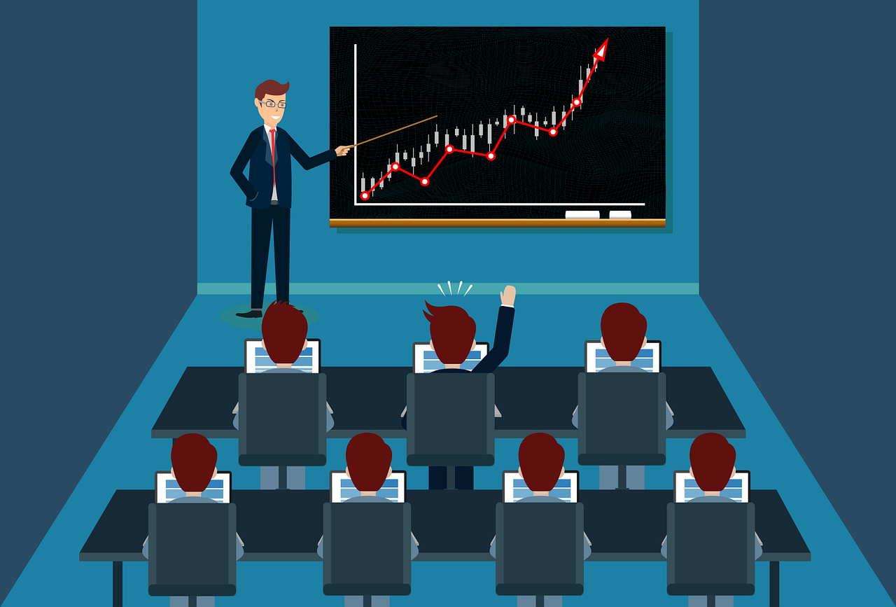
Extension
Calculate the difference between the teacher's noise and the noise from activity A3, A4, and A5 and comment about your results:
A3 - A2 = __________
A4 - A2= __________
A5 - A2 = __________

