Slide 1
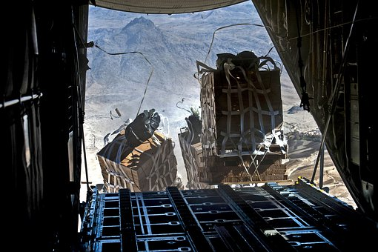
Drop it!
Designing a system to drop emergency aid pallets
from an aircraft

Slide 2
Stay safe
Whether you are a scientist researching a new medicine or an engineer solving climate change, safety always comes first. An adult must always be around and supervising when doing this activity. You are responsible for:
ensuring that any equipment used for this activity is in good working condition
behaving sensibly and following any safety instructions so as not to hurt or injure yourself or others
Please note that in the absence of any negligence or other breach of duty by us, this activity is carried out at your own risk. It is important to take extra care at the stages marked with this symbol: ⚠

Slide 3
Design brief
People in countries affected by natural disasters or war often need food, water, shelter and other aid delivered to them.
This can be done by air, but a method is needed to safely and securely drop this aid from the aircraft to the ground
Your task is to design a system that could be used to drop emergency aid from an aircraft to where it is needed on the ground. You should consider the type of aid that might be needed and how this could be kept secure during delivery
Notes:
The crisis in Ukraine could be used as an example for context.
Discuss the types of aid that might need delivering and the requirements for keeping them safe during delivery:
Food - it is essential in every crisis to first determine whether food supply is a correct response.
Shelter - shelter is a critical to survival in the initial stages of a disaster.
Non-food items - water, sanitation and hygiene Promotion.

Slide 4
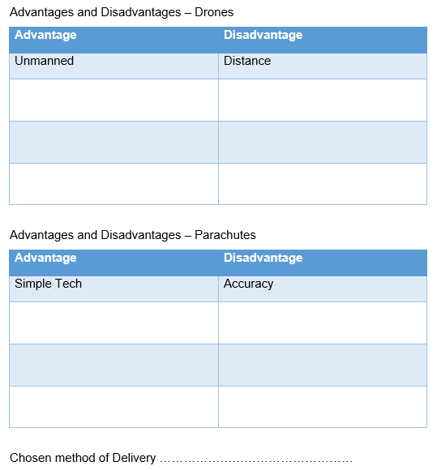
Existing methods
Drones and parachutes are two existing methods of solving this problem
What are their advantages and disadvantages?
Notes:
Discuss existing methods used, such as drones and parachutes.
What are their advantages and disadvantages?
Learners to fill in the table on the activity sheet.

Slide 5
Producing your designs
Choose one of the methods analysed in the previous activity
On your worksheet, sketch ideas for an improved and new version of your chosen method
Take the best parts of each idea and combine them into a developed design
Now combine all you have done into the best drawing you can do – this will be your final design. It can be drawn from more than one viewpoint
Notes:
Ask learners to consider potential added features e.g.:
How are you going to let people know where the package is once it has landed?
How could people locate it once it has been delivered?
How are you going make sure the parcel arrives safely?
You want to avoid heavy crash landings - how could you “soften” the landing?
Add this detail to the designs - this is called Iteration.

Slide 6
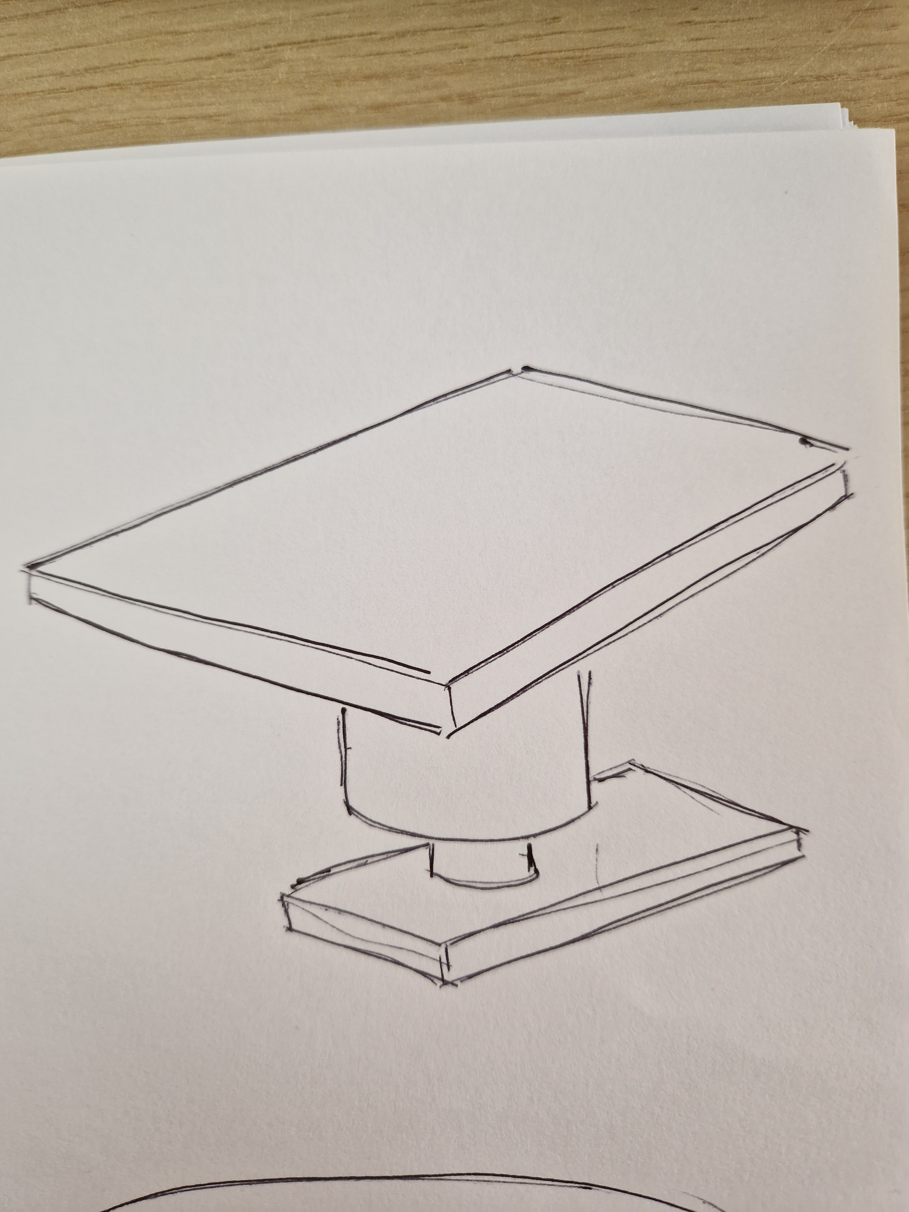
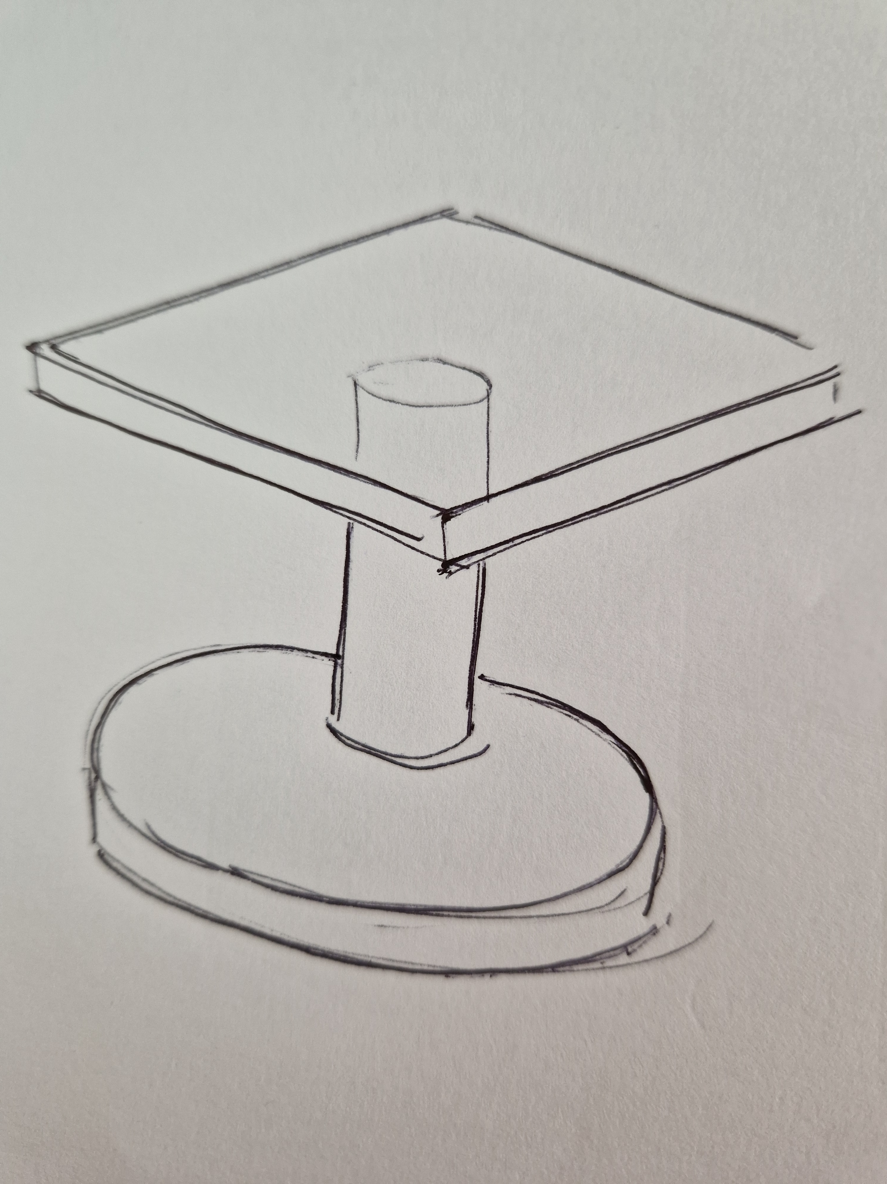
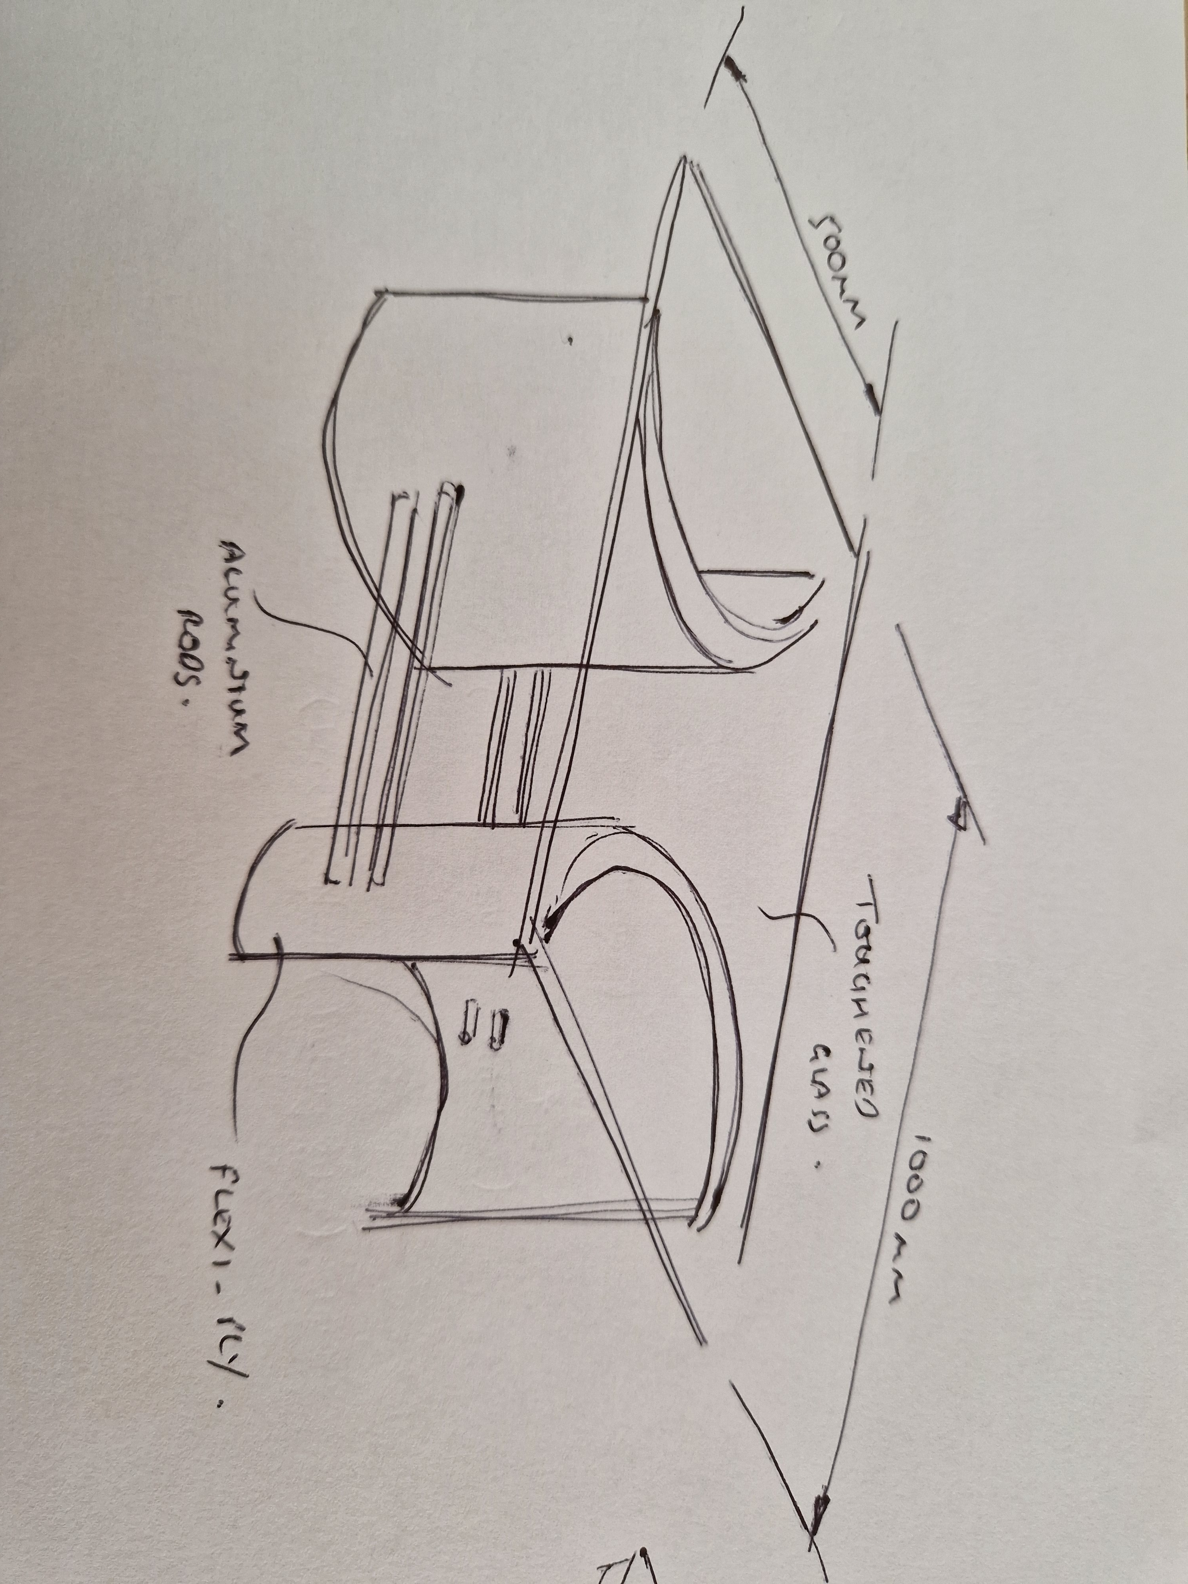
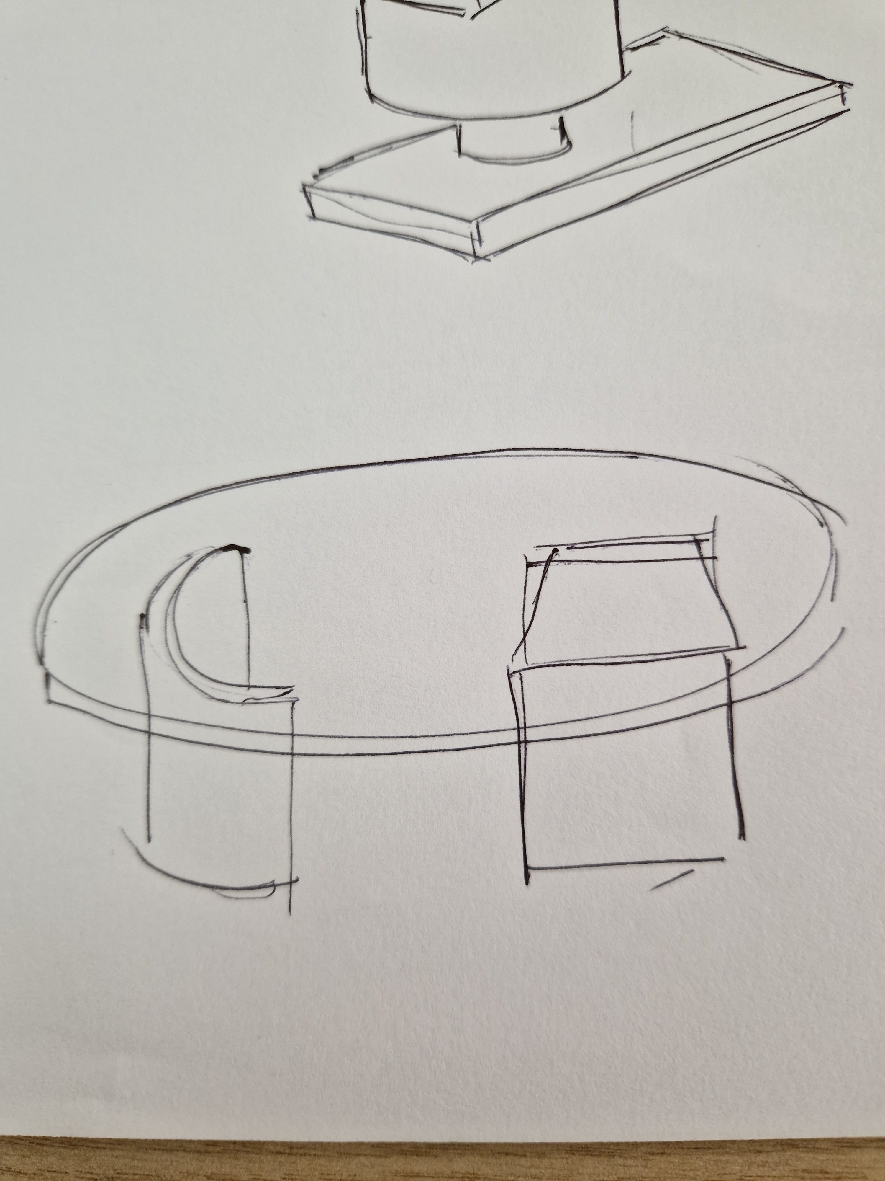
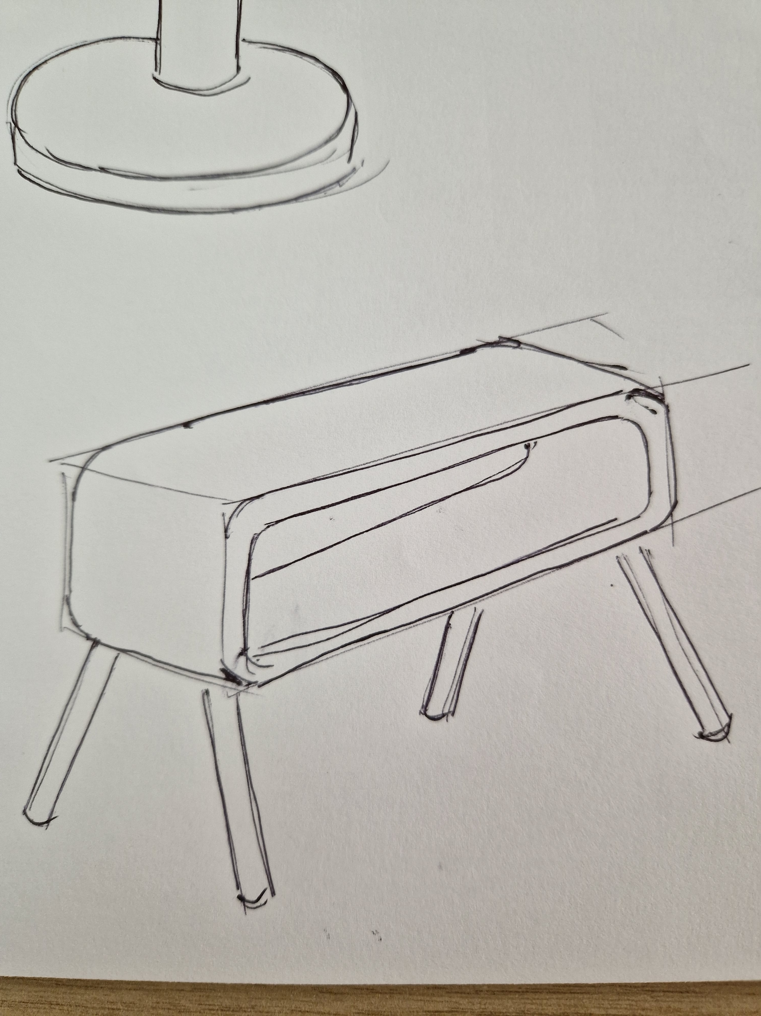
Development example (for a different product!)
Idea 2
Idea 1
Made from Flexi-Ply
Polyurethane varnish to protect
Toughened glass top, held in position due to weight – may need cushioning
Idea 4
Idea 3
Notes:
As an extension, learners could produce a card model of their design.

Slide 7
User evaluation of design
Person | Feedback Comments
Parent
Teacher
Classmate
What went well?
Even better if …..
Notes:
Ask learners to show their designs to a variety of people in the class (or at home if possible) and note down their opinions/comments.

