Slide 1
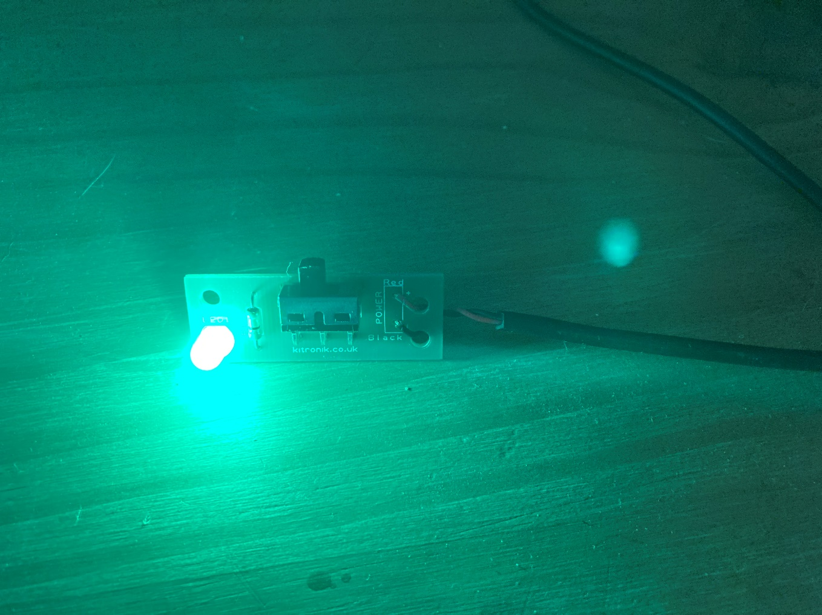
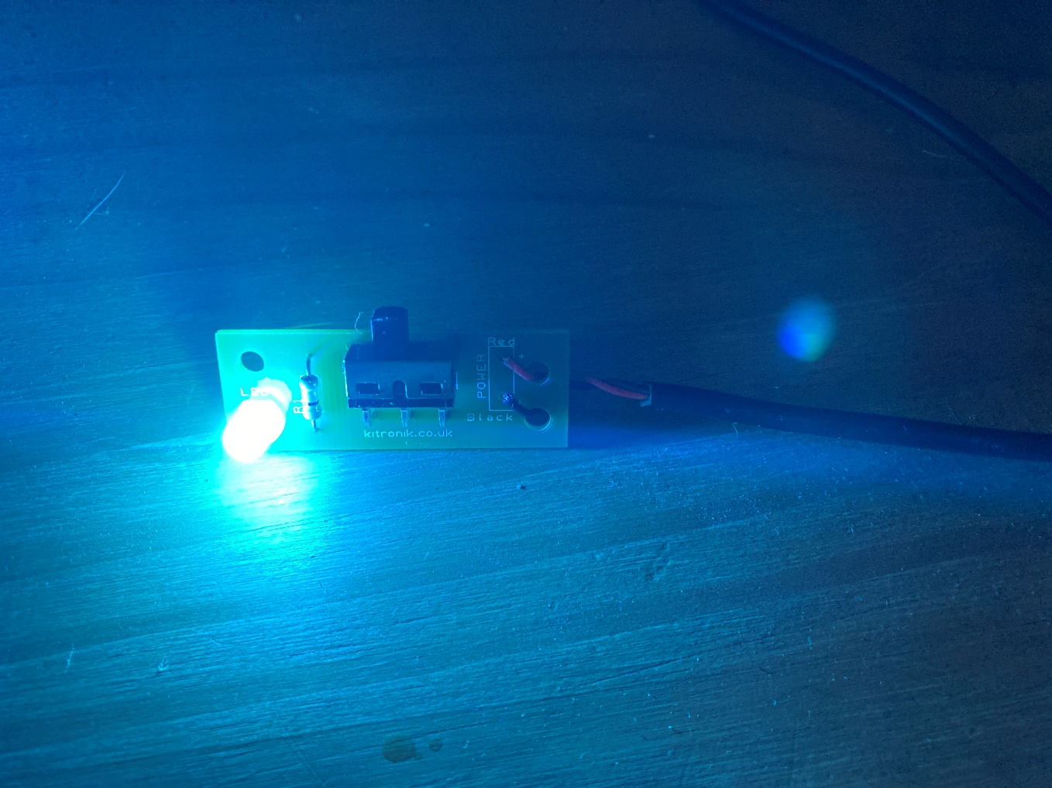
Cabin mood lighting
Using colour-changing LEDs for mood lighting within an aircraft cabin

Slide 2
Stay safe
Whether you are a scientist researching a new medicine or an engineer solving climate change, safety always comes first. An adult must always be around and supervising when doing this activity. You are responsible for:
ensuring that any equipment used for this activity is in good working condition
behaving sensibly and following any safety instructions so as not to hurt or injure yourself or others
Please note that in the absence of any negligence or other breach of duty by us, this activity is carried out at your own risk. It is important to take extra care at the stages marked with this symbol: ⚠

Slide 3
Brief
Flying can be a stressful experience for many people, especially when travelling long distances.
Mood lighting can be used to help people relax and enjoy the flight.
Your task is to make a colour-changing mood light that can be used to help travellers relax within a commercial aircraft cabin.
The mood light must have a suitable power supply so it can be easily plugged in and used during the flight.

Slide 4
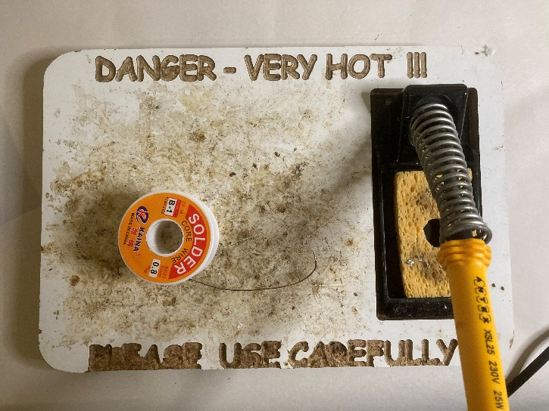
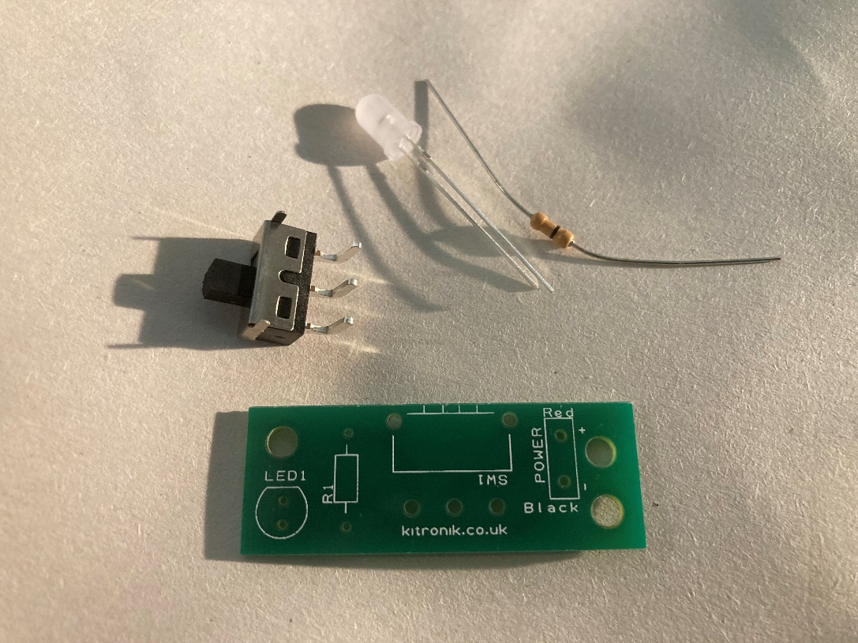
Resources
Soldering iron, stand and mat/base
Solder
Mood light circuit board
4.5 V power supply e.g. a USB cable
Slide switch
5 mm colour changing LED
Protective resistor for the LED
Notes:
Lead free solder should be used for safety. If permanent fume extraction is not present in the room then portable extraction units will be needed. Safety glasses should be worn during all soldering and wiring activities.
The circuit board used in this example is the Kitronik mood light PCB, available here: https://kitronik.co.uk/products/2131-colour-changing-usb-lamp-kit
Alternatively a custom made PCB could be produced, or stripboard could be used.

Slide 5
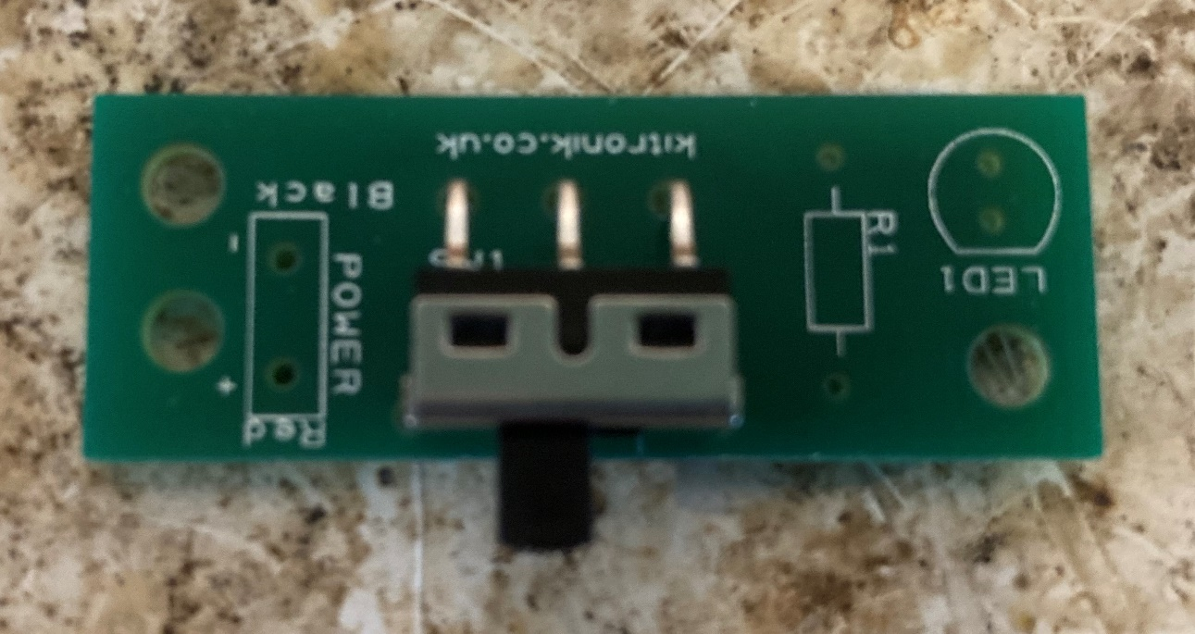
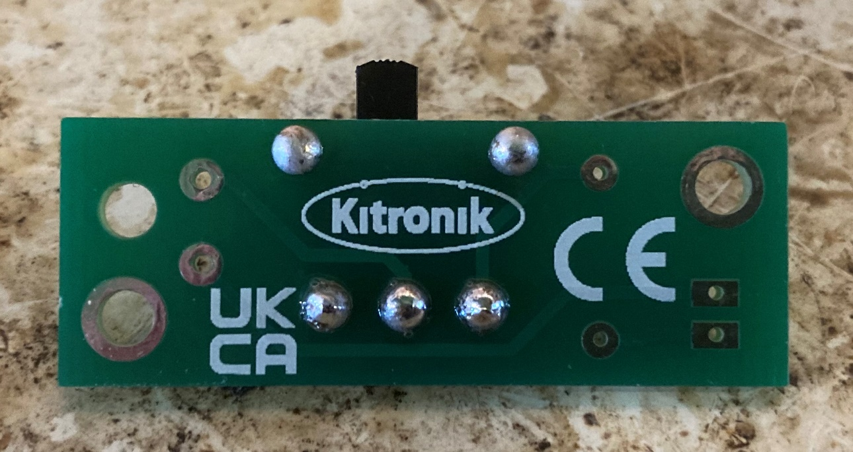
Step 1 – Attaching the switch
⚠
Mount the switch on the plastic side of the PCB
Push down as far as it will go
Solder the switch legs to the pads on the track side of the PCB
Notes:
The switch should be mounted as flat as possible on the plastic side of the PCB.
Demonstrate safe use of soldering equipment prior to learners attempting this step. A visualiser or small webcam linked to a projector screen would help with this. Safety glasses should be worn at all times. All soldering should be done on a mat or board to avoid damage to desks. A sponge should be used to regularly clean the soldering iron tip. The iron should be placed in its stand at all times when not in use.

Slide 6
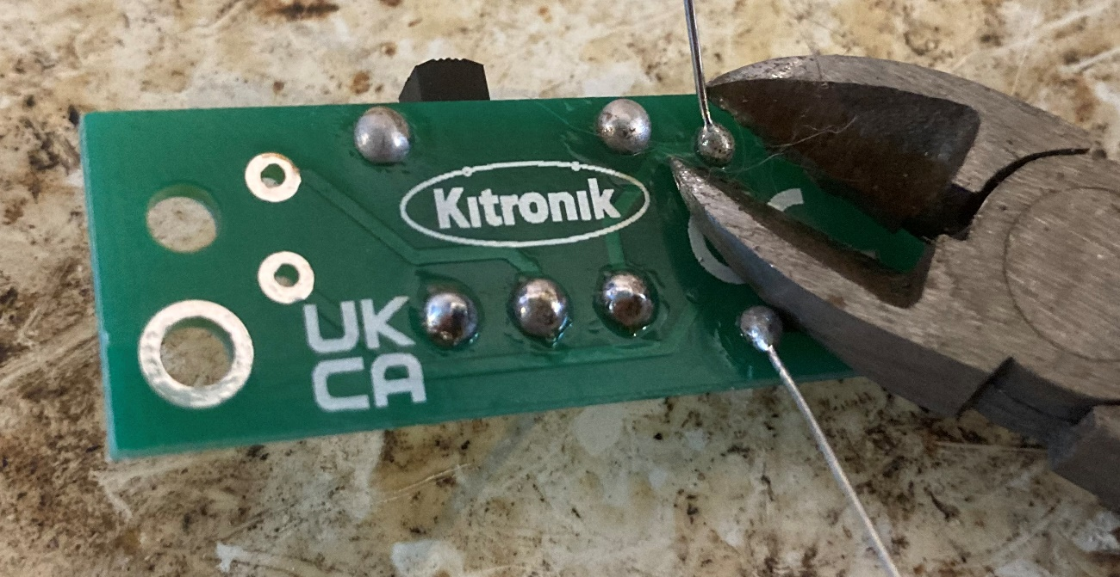
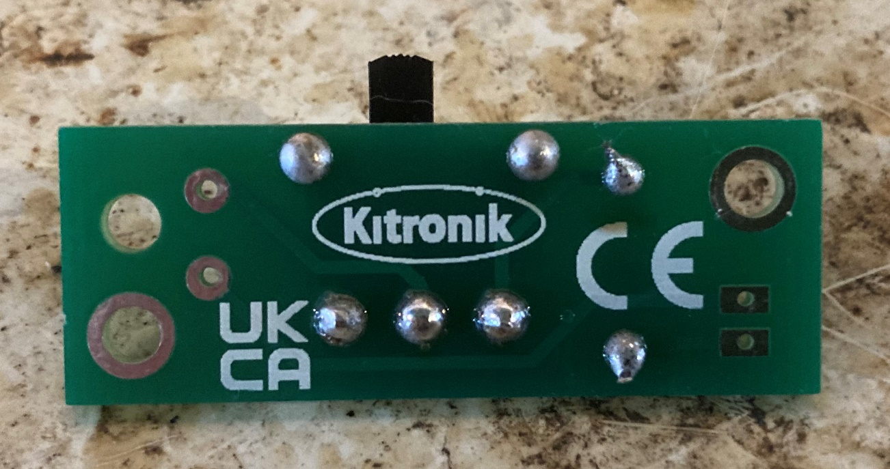
Step 2 – Attaching the resistor
⚠
Mount the resistor on the plastic side of the PCB
Solder the resistor legs to the pads on the track side of the PCB
Use wire cutters to cut away any excess wire
Notes:
The resistor should be mounted as flat as possible on the plastic side of the PCB. It is non-polarised so can be mounted either way around.

Slide 7
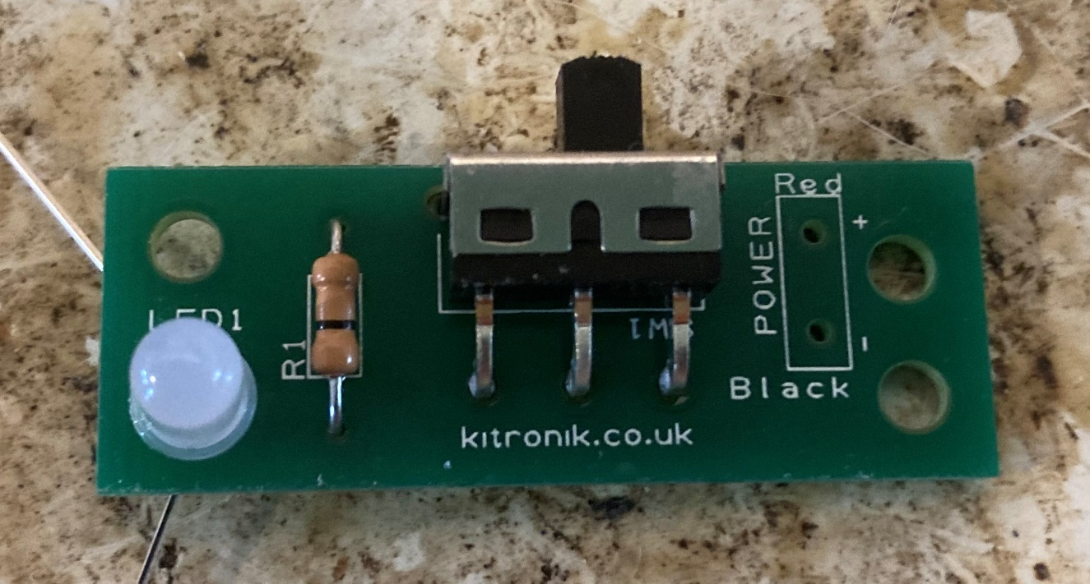
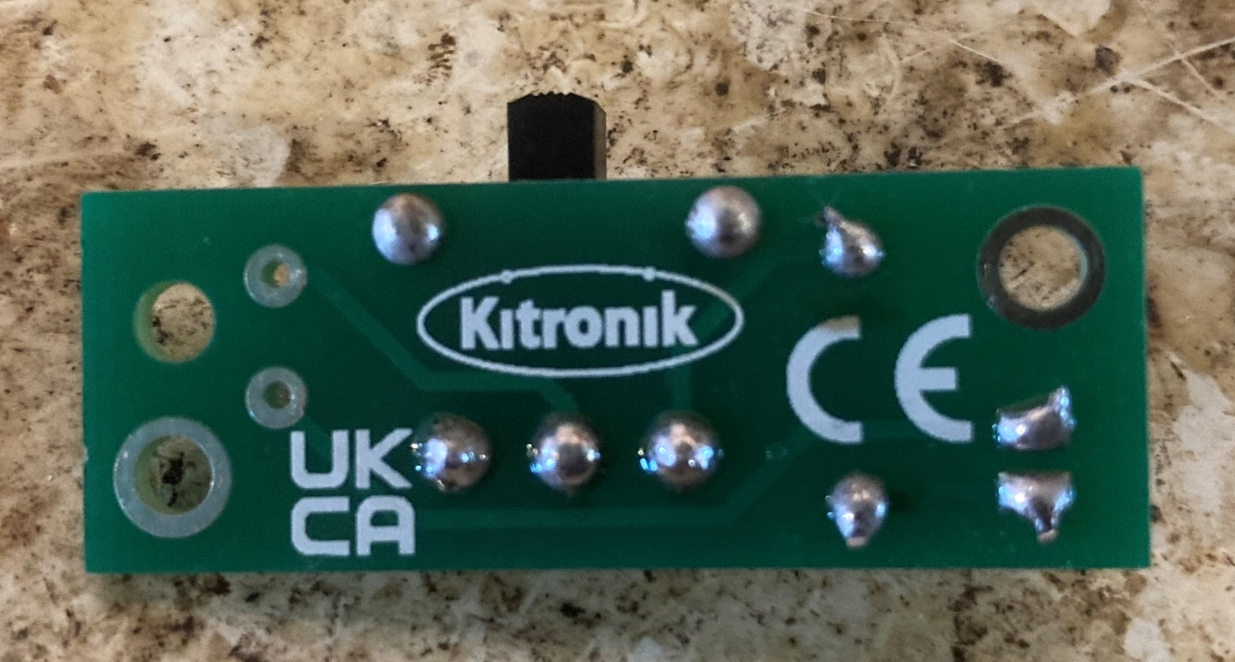
Step 3 – Attaching the LED
⚠
Mount and solder the LED to the PCB
Make sure that the round and flat sides match the markings on the board!
Snip the ends when soldered
Notes:
The LED is a polarised component so must be connected the right way round – as shown on the circuit board markings (flat side at the top).

Slide 8
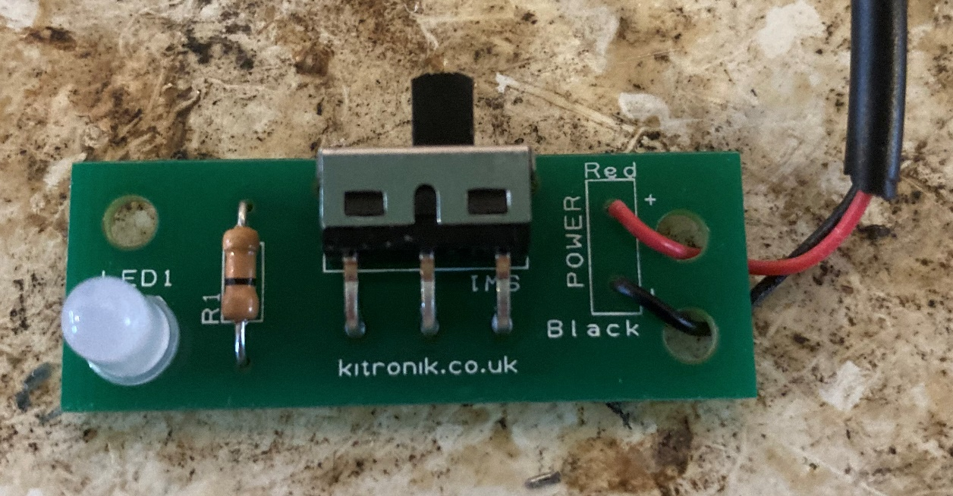
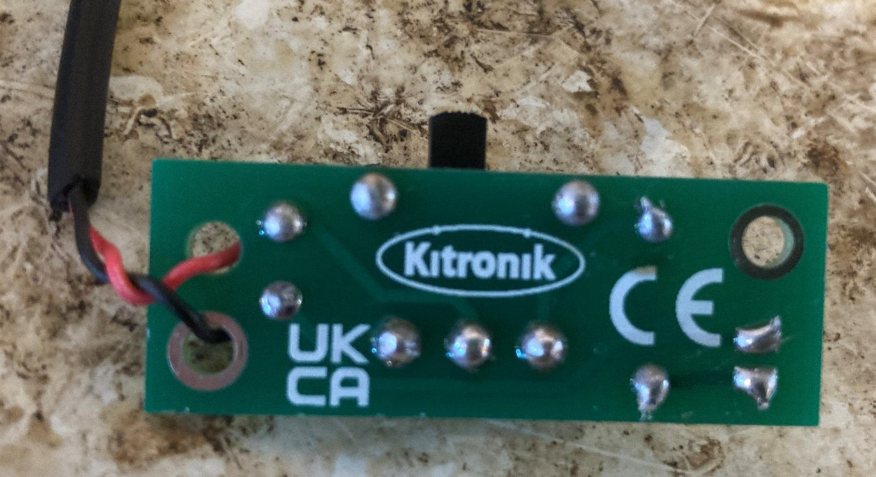
Step 4 – Power wires
⚠
Mount and solder the power wires to the PCB. The red wire goes to ‘+’ and the black wire goes to ‘-’
Place the wires through the strain holes before soldering
Snip the ends when soldered
Notes:
The power supply wires must be connected as shown or the circuit will not work. Twisting the wires together will make the wiring neater and less likely to break. A 4.5 V power supply is needed – this could be provided via a USB cable or a battery pack (3 x AA batteries).

Slide 9
Finished example
Notes:
An example of a finished circuit with all components in place and ready to test.

Slide 10
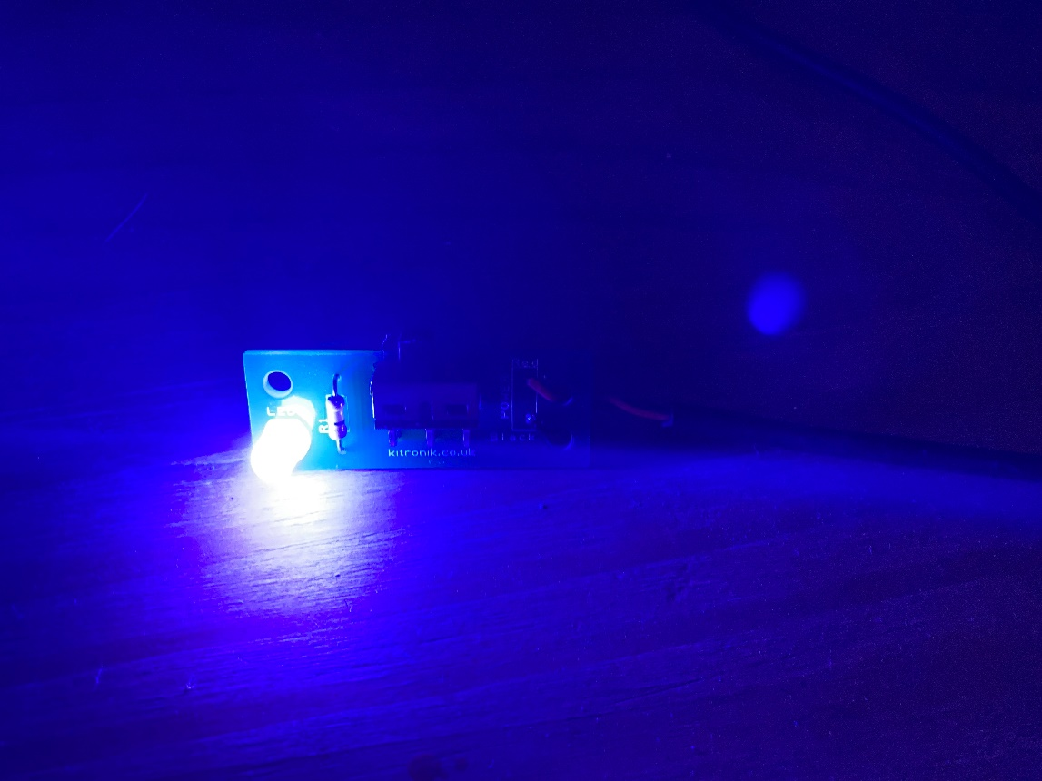
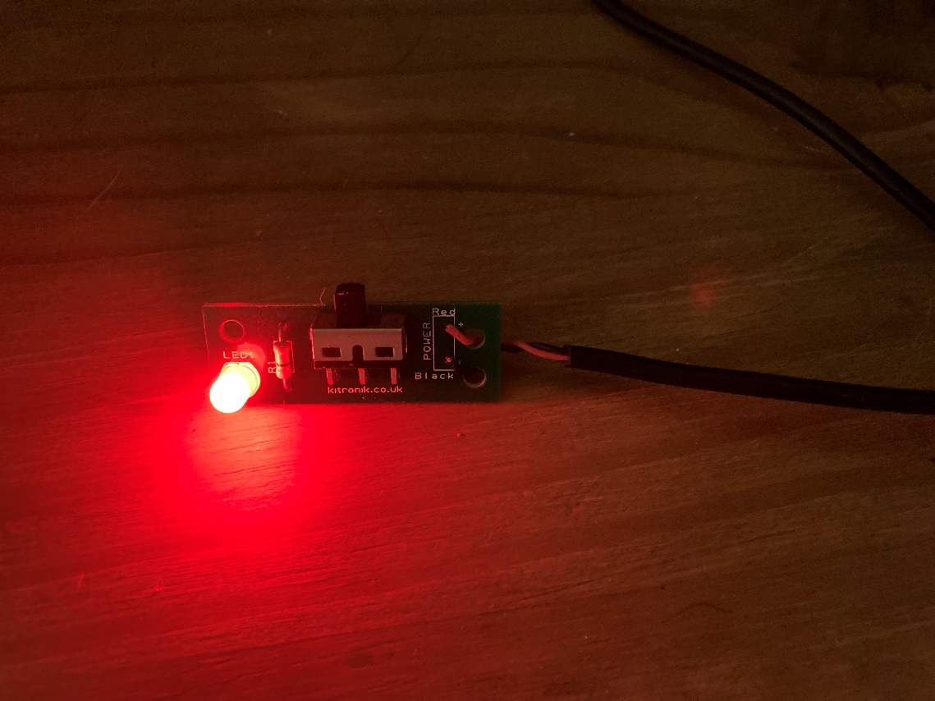
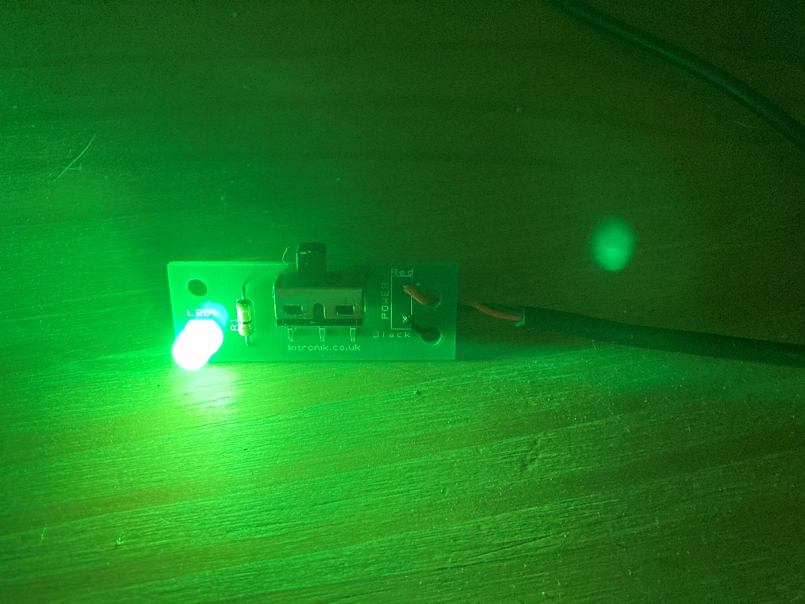
Testing
Plug in the USB power supply or attach the battery pack
Turn the switch ‘on’
Notes:
When the power supply is connected and the switch turned on, the LED should cycle between a range of different colours. Discuss with learners which colours would be the most relaxing and soothing for use in the cabin. It is strongly recommended that the teacher checks the circuit for any errors (such as components the wrong way around or short circuits) before testing, as connecting a USB power supply to a faulty circuit could create safety issues, cause damage to the system providing the USB power, or further damage the constructed mood light circuit itself.

